Slide 1
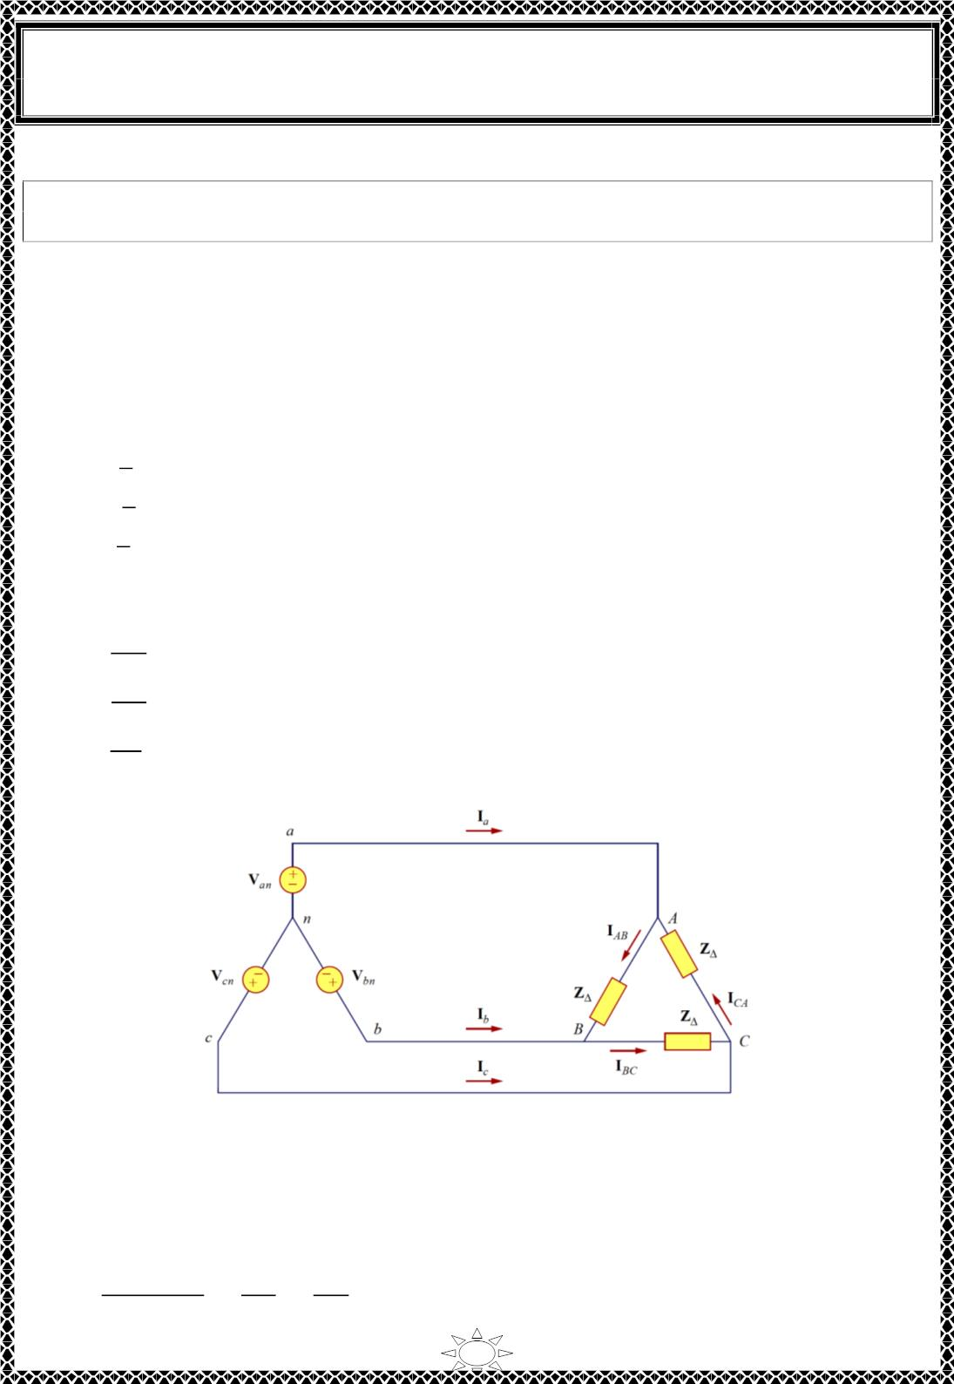
University of Diyala
Engineering College
Electronic Department
Electrical Circuits
2nd Class
Lecturer : Wisam N. AL-Obaidi
Year (2015-2016)
3.2) Balanced Wye-Delta Connection
A balanced Y- ∆ system consists of a balanced Y-connected source feeding a
balanced ∆-connected load.
The balanced Y-delta system is shown in Fig.3.7, where the source is Y-connected and the
load is ∆-connected. There is, of course, no neutral connection from source to load for this
case. Assuming the positive sequence, the phase voltages are again
푉 = 푉 ∠0ꢀ
푎푛
푝
푉
푏푛
= 푉_{푝}∠−120ꢀ}
(ퟑ. ퟏퟗ)
푉 = 푉 ∠+120ꢀ
푐푛
푝
While the line voltages (as shown in section 3.1),
푉
푎푏
^{= √3 푉}푝^{∠30ꢀ = 푉}
퐴퐵
푉 = √3 푉 ∠ − 90ꢀ = 푉 }
퐵퐶
(ퟑ. ퟐퟎ)
푏푐
푝
푉 = √3 푉 ∠ − 150ꢀ = 푉
퐶퐴
푐푎
푝
showing that the line voltages are equal to the voltages across the load impedances for this
system configuration. From these voltages, we can obtain the phase currents as
Trail Version
Trail Version
Trail Version
Trail Version
Trail Version
Trail Version
Trail Version
Trail Version
Trail Version
Trail Version
Trail Version
Trail Version
Trail Version
퐼
=
=
=
ꢁꢂꢃ
푍∆
ꢁꢃꢄ
푍∆
ꢁꢄꢂ
푍
∆
퐴퐵
퐼_{퐵퐶}
(ퟑ. ퟐퟏ)
^{퐼}퐶퐴
ꢅ
These currents have the same magnitude but are out of phase with each other by 120⁰.
Fig.3.7 Balanced Y-∆ connection
Another way to get these phase currents is to apply KVL. For example, applying KVL
around loop aABbna gives
−푉 + ꢉ 퐼 + 푉 = 0
푎푛
∆ 퐴퐵
푏푛
or
푉 − 푉
푎푛
푉
푉
퐴퐵
ꢉ∆
퐼
=
푏푛
=
푎푏
=
(3.22)
퐴퐵
ꢉ∆
ꢉ∆
11

Slide 2
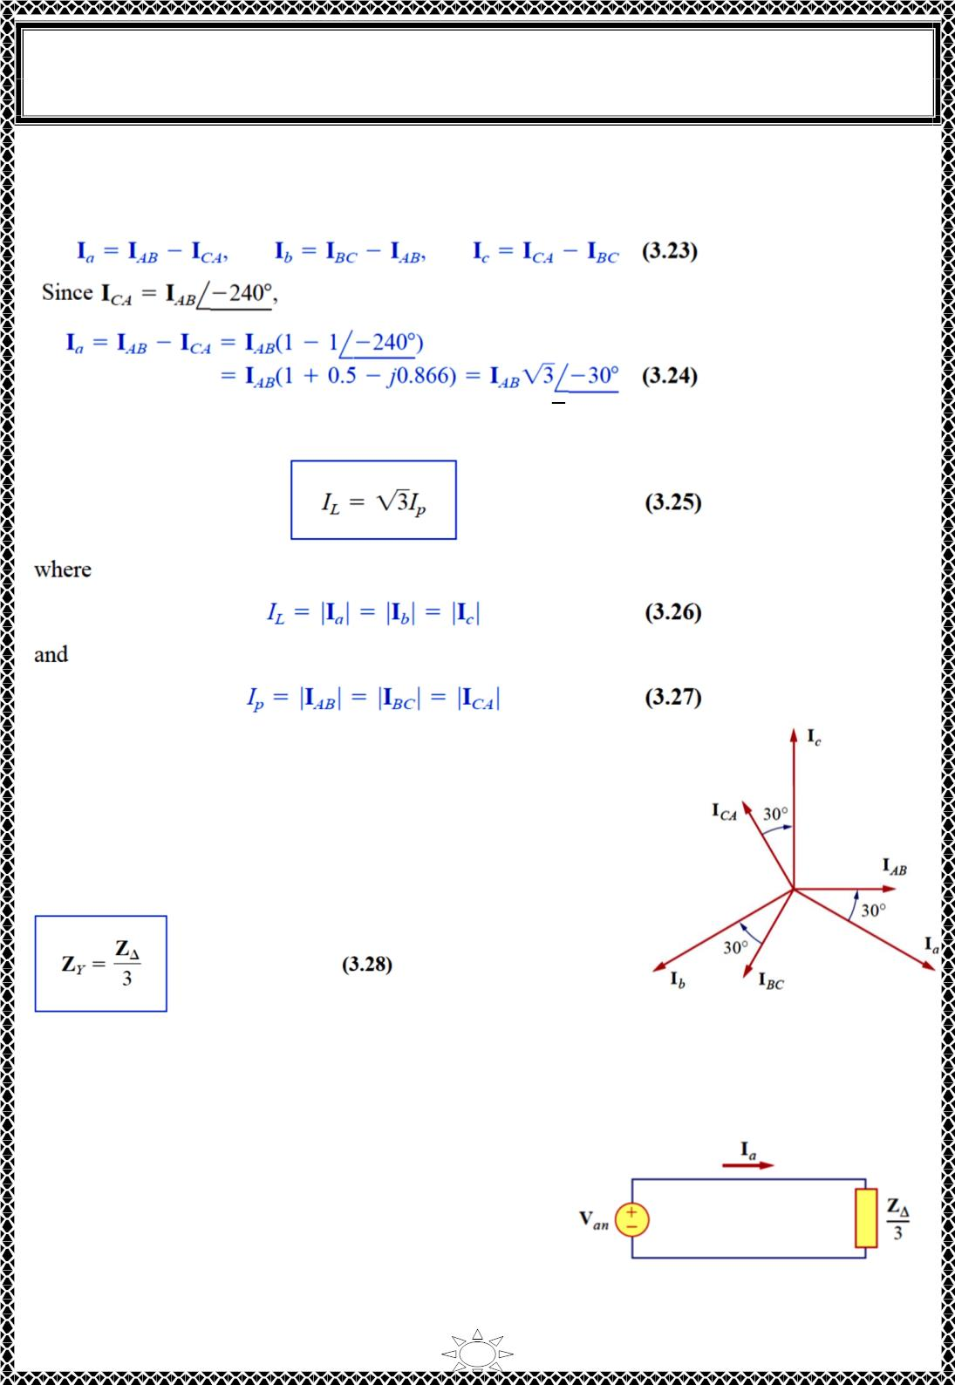
University of Diyala
Engineering College
Electronic Department
Electrical Circuits
2nd Class
Lecturer : Wisam N. AL-Obaidi
Year (2015-2016)
which is same as Eq. (3.21). This is the more general way of finding the phase currents.
The line currents are obtained from the phase currents by applying KCL at nodes A, B, and
C. Thus,
showing that the magnitude I of the line current is √3 times the magnitude I of the phase
current, or
L
p
Trail Version
Trail Version
Trail Version
Trail Version
Trail Version
Trail Version
Trail Version
Trail Version
Trail Version
Trail Version
Trail Version
Trail Version
Trail Version
Also, the line currents lag the corresponding phase currents
by 30⁰ assuming the positive sequence. Fig.3.8 is a phasor
diagram illustrating the relationship between the phase and
line currents.
An alternative way of analyzing the Y-∆ circuit is to
transform the ∆-connected load to an equivalent Y-connected
load. Using the Y-∆ transformation formula in Eq. (3.8),
Fig.3.8 Phasor diagram illustrating the
relationship between phase and line currents
After this transformation, we now have a Y-Y system as in Fig.3.4. The three-phase Y-∆
system in Fig.3.7 can be replaced by the singlephase
equivalent circuit in Fig.3.9. This allows us to
calculate only the line currents. The phase currents
are obtained using Eq. (3.25) and utilizing the fact
that each of the phase currents leads the
corresponding line current by 30⁰.
Fig.3.9 A single-phase equivalent circuit
of a balanced Y-∆ circuit.
12

Slide 3
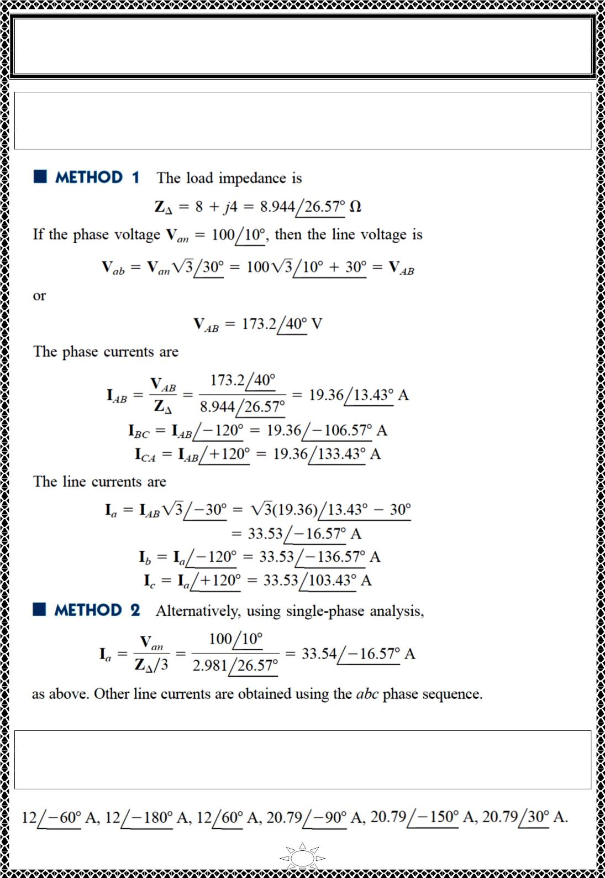
University of Diyala
Engineering College
Electronic Department
Electrical Circuits
2nd Class
Lecturer : Wisam N. AL-Obaidi
Year (2015-2016)
Example 3: A balanced abc-sequence Y-connected source with Van = ퟏퟎퟎ∠ ퟏퟎ^{ퟎ 퐕} is
connected to a ∆-connected balanced load (8+j4)Ω per phase. Calculate the phase and line
currents.
Solution: This can be resolved in two ways,
Trail Version
Trail Version
Trail Version
Trail Version
Trail Version
Trail Version
Trail Version
Trail Version
Trail Version
Trail Version
Trail Version
Trail Version
Trail Version
푽 . If
H.W.3: One line voltage of a balanced Y-connected source is 푽_{푨푩} = ퟐퟒퟎ∠−ퟐퟎ^{ퟎ}
the source is connected to a ∆-connected load of ퟐퟎ∠ퟒퟎ^{ퟎΩ,} find the phase and line
currents. Assume the abc sequence.
Answer:
13

Slide 4
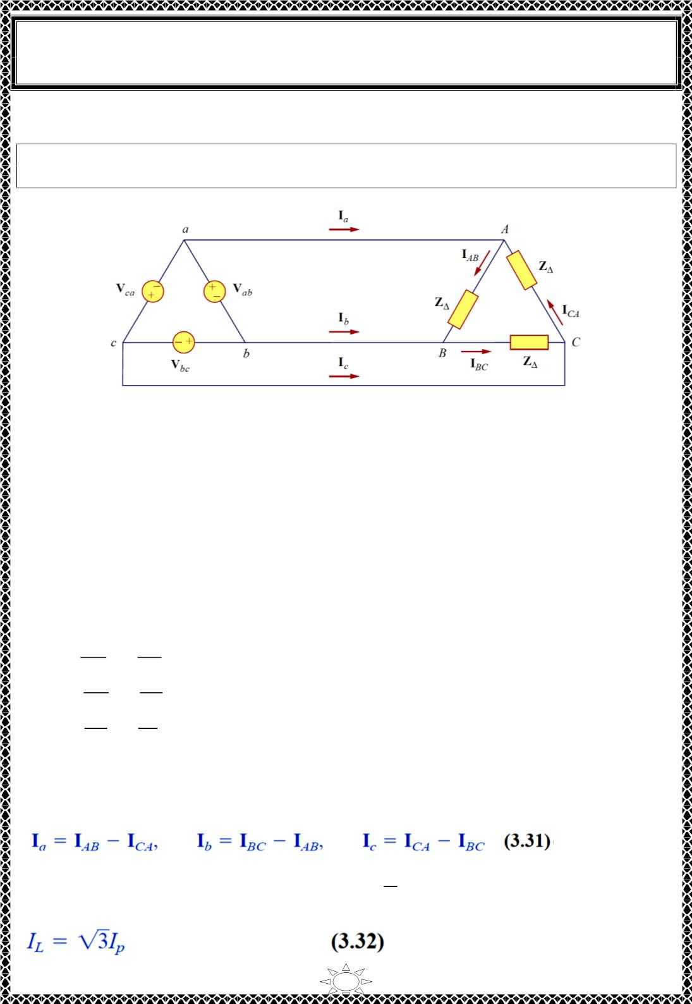
University of Diyala
Engineering College
Electronic Department
Electrical Circuits
2nd Class
Lecturer : Wisam N. AL-Obaidi
Year (2015-2016)
3.3) Balanced Delta-Delta Connection
A balanced ∆-∆ system is one in which both the balanced source and balanced
load are ∆-connected.
The source as well as the load may be delta-connected as shown in Fig.3.10.
Fig.3.10 A balanced ∆-∆ connection.
Assuming a positive sequence, the phase voltages for a delta-connected source are
Trail Version
Trail Version
Trail Version
Trail Version
Trail Version
Trail Version
Trail Version
Trail Version
Trail Version
Trail Version
Trail Version
Trail Version
Trail Version
푉
푎푏
^{= 푉}푝^{∠0ꢀ = 푉}
퐴퐵
푉 = 푉 ∠ − 120ꢀ = 푉 }
(ퟑ. ퟐퟗ)
푏푐
푝
퐵퐶
푉 = 푉 ∠ + 120ꢀ = 푉
푐푎
푝
퐶퐴
The line voltages are the same as the phase voltages. From Fig.3.10, assuming there is no
line impedances, the phase voltages of the deltaconnected source are equal to the voltages
across the impedances.
The phase currents are,
퐼
ꢁꢂꢃ
푍∆
ꢁꢃꢆ
푍∆
ꢁꢆꢂ
푍∆
ꢁꢄꢅ
푍∆
ꢁꢅꢇ
푍∆
ꢁ
ꢇꢄ
푍∆
퐴퐵
=
=
=
=
=
=
퐼_{퐵퐶}
(ퟑ. ퟑퟎ)
^{퐼}퐶퐴
ꢈ
Since the load is delta-connected just as in the previous section, some of the formulas
derived there apply here. The line currents are obtained from the phase currents by
applying KCL at nodes A, B, and C, as we did in the previous section:
Also, as shown in the last section, each line current lags the corresponding phase current
by 30⁰; the magnitude I of the line current is √3 times the magnitude I of the phase
current,
L
n
14

Slide 5
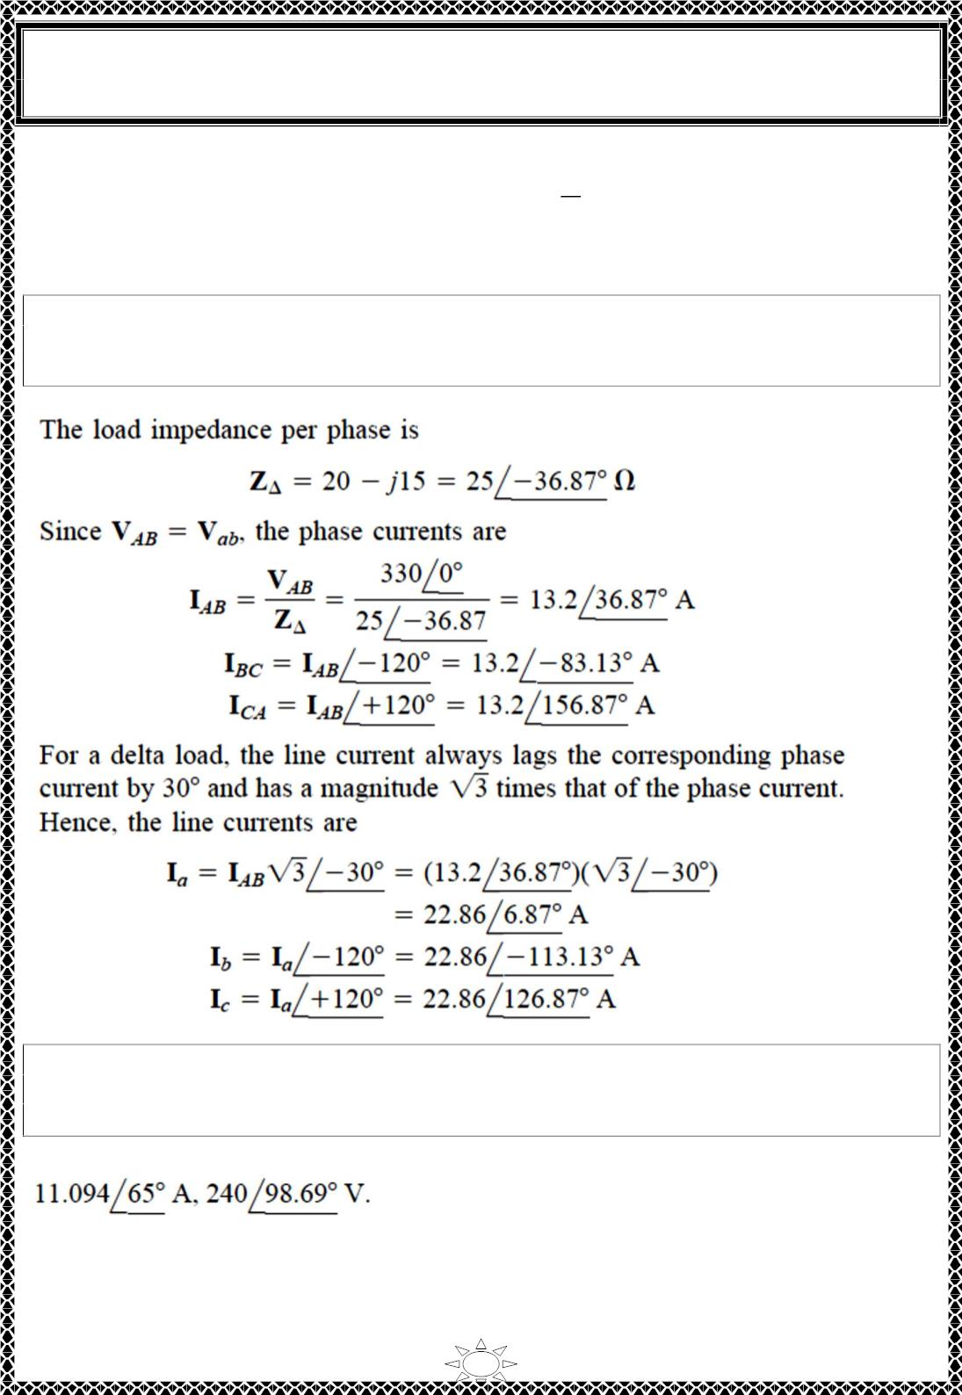
University of Diyala
Engineering College
Electronic Department
Electrical Circuits
2nd Class
Lecturer : Wisam N. AL-Obaidi
Year (2015-2016)
An alternative way of analyzing the ∆-∆ circuit is to convert both the source and the load
^{풁}∆
ퟑ
to their Y equivalents. We already know that 풁_{풀} =
to a Y-connected source, see the next section.
. To convert a ∆-connected source
Example 4: A balanced ∆-connected load having an impedance (20 – j15) Ω is
connected to ∆-connected, positive-sequence generator having Vab
a
=
ퟑퟑퟎ∠ ퟎ^{ퟎ} 퐕 .Calculate the phase currents of the load and the line currents.
Solution:
Trail Version
Trail Version
Trail Version
Trail Version
Trail Version
Trail Version
Trail Version
Trail Version
Trail Version
Trail Version
Trail Version
Trail Version
Trail Version
H.W.4:
A positive-sequence, balanced ∆-connected source supplies a balanced ∆-
connected load. If the impedance per phase of the load is (18 + j12) Ω and 푰 =
ퟏퟗ. ퟐퟎퟐ∠ퟑퟓ^{ퟎ} 퐴. Find 푰_{푨푩} and 푽_{푨푩}
풂
Answer:
15

Slide 6
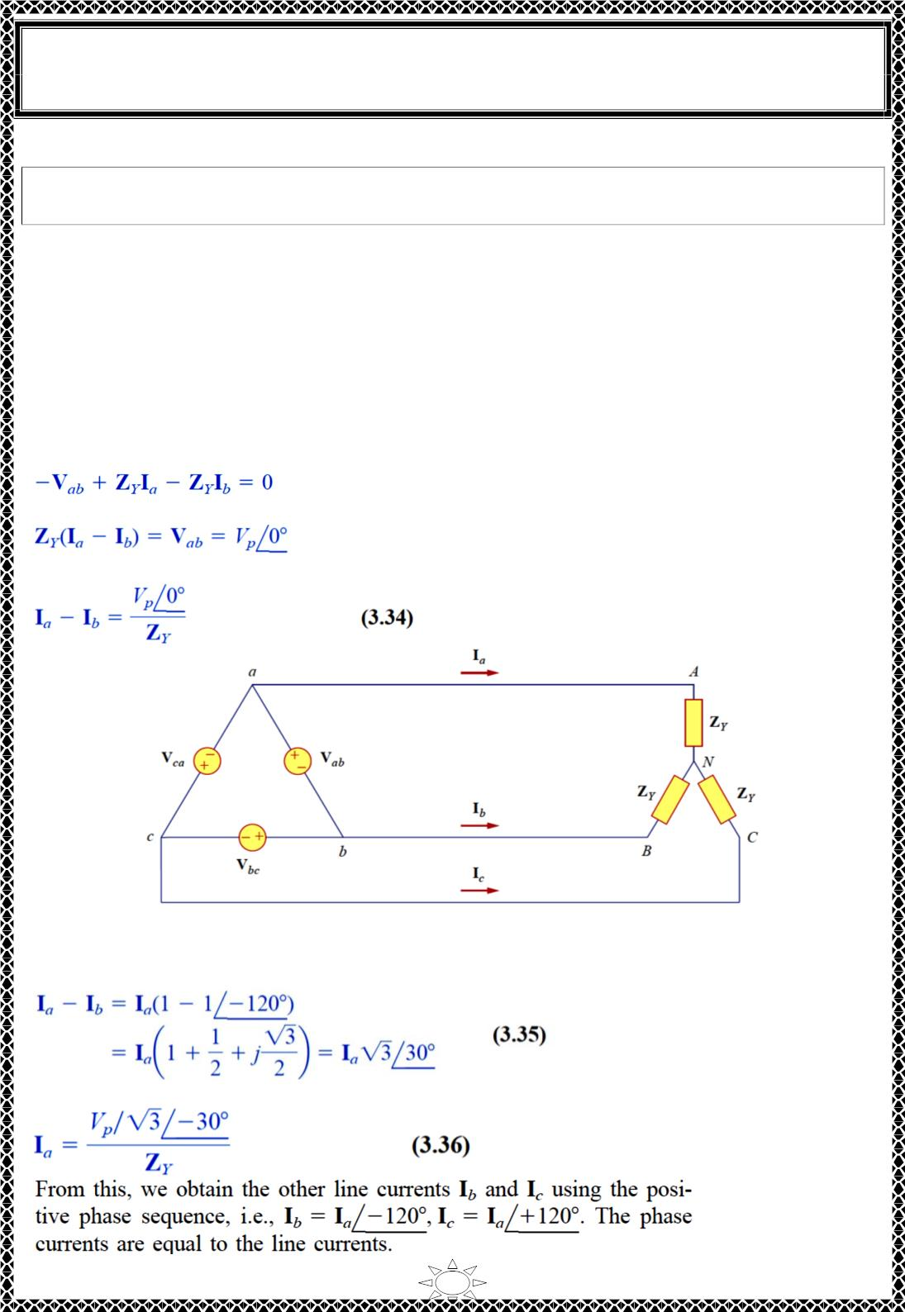
University of Diyala
Engineering College
Electronic Department
Electrical Circuits
2nd Class
Lecturer : Wisam N. AL-Obaidi
Year (2015-2016)
3.4) Balanced Delta-Wye Connection
A balanced ∆-Y system consists of a balanced ∆-connected source feeding a
balanced Y-connected load.
Consider the ∆-Y circuit in Fig.3.11. Again, assuming the abc sequence, the phase
voltages of a delta-connected source are
푉
푎푏
= 푉_{푝}∠0ꢀ
푉 = 푉 ∠ − 120ꢀ }
(ퟑ. ퟑퟑ)
푏푐
푝
푉 = 푉 ∠ + 120ꢀ
푐푎
푝
These are also the line voltages as well as the phase voltages.
We can obtain the line currents in many ways. One way is to apply KVL to loop aANBba
in Fig.3.11, writing
or
Thus,
Trail Version
Trail Version
Trail Version
Trail Version
Trail Version
Trail Version
Trail Version
Trail Version
Trail Version
Trail Version
Trail Version
Trail Version
Trail Version
Fig.3.11 A balanced ∆-Y connection
ꢀ
But I lags I by 120⁰, since we assumed the abc sequence; that is 퐼 = 퐼 ∠−120 ,Hence,
b
a
푏
푎
Substituting eq.(3.35) into Eq. (3.34) gives,
16

Slide 7
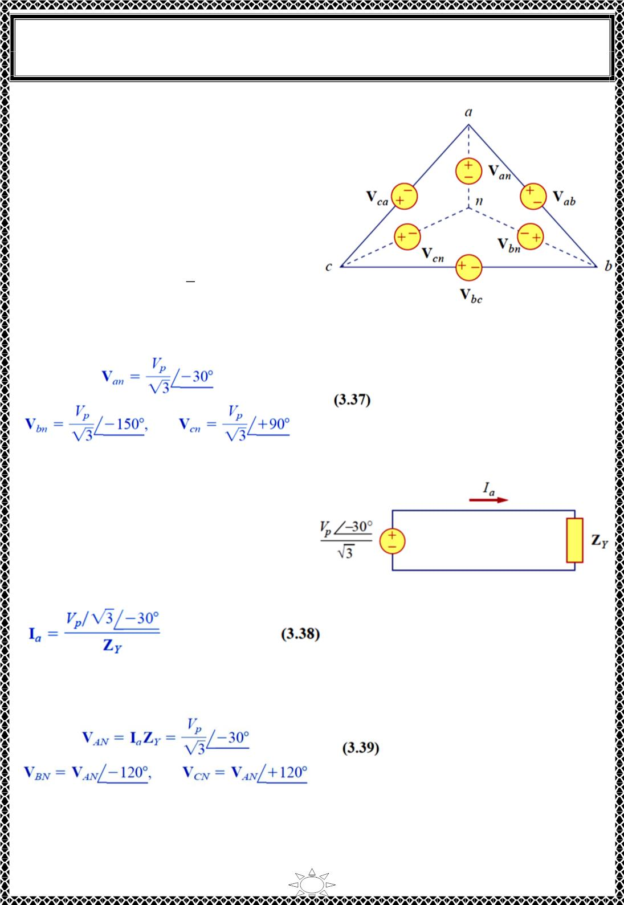
University of Diyala
Engineering College
Electronic Department
Electrical Circuits
2nd Class
Lecturer : Wisam N. AL-Obaidi
Year (2015-2016)
Another way to obtain the line currents is to
replace the deltaconnected source with its
equivalent wye-connected source, as shown
in Fig.3.12. In Section 3.1, we found that the
line-to-line voltages of a wye-connected
source lead their corresponding phase
voltages by 30⁰ . Therefore, we obtain each
phase
voltage
of
the
equivalent
wyeconnected source by dividing the
corresponding line voltage of the delta-
connected source by √3 and shifting its
phase by -30⁰ . Thus, the equivalent wye-
connected source has the phase voltages
Fig.3.12 Transforming a ∆-connected source
to an equivalent Y-connected source.
Trail Version
Trail Version
Trail Version
Trail Version
Trail Version
Trail Version
Trail Version
Trail Version
Trail Version
Trail Version
Trail Version
Trail Version
Trail Version
If the delta-connected source has source impedance Zs per phase, the equivalent wye-
connected source will have a source
impedance of (Zs/3) per phase.
Once the source is transformed to wye, the
circuit becomes
a
wyewye system.
Therefore, we can use the equivalent single-
phase circuit shown in Fig.3.13, from which
the line current for phase a is
Fig.3.12 The single-phase equivalent circuit
which is the same as Eq. (3.37).
Alternatively, we may transform the wye-connected load to an equivalent delta-connected
load. This results in a ∆-∆ system, which can be analyzed as in Section 3.3. Note that
As stated earlier, the delta-connected load is more desirable than the wye-connected load.
It is easier to alter the loads in any one phase of the delta-connected loads, as the
individual loads are connected directly across the lines. However, the delta-connected
17

Slide 8
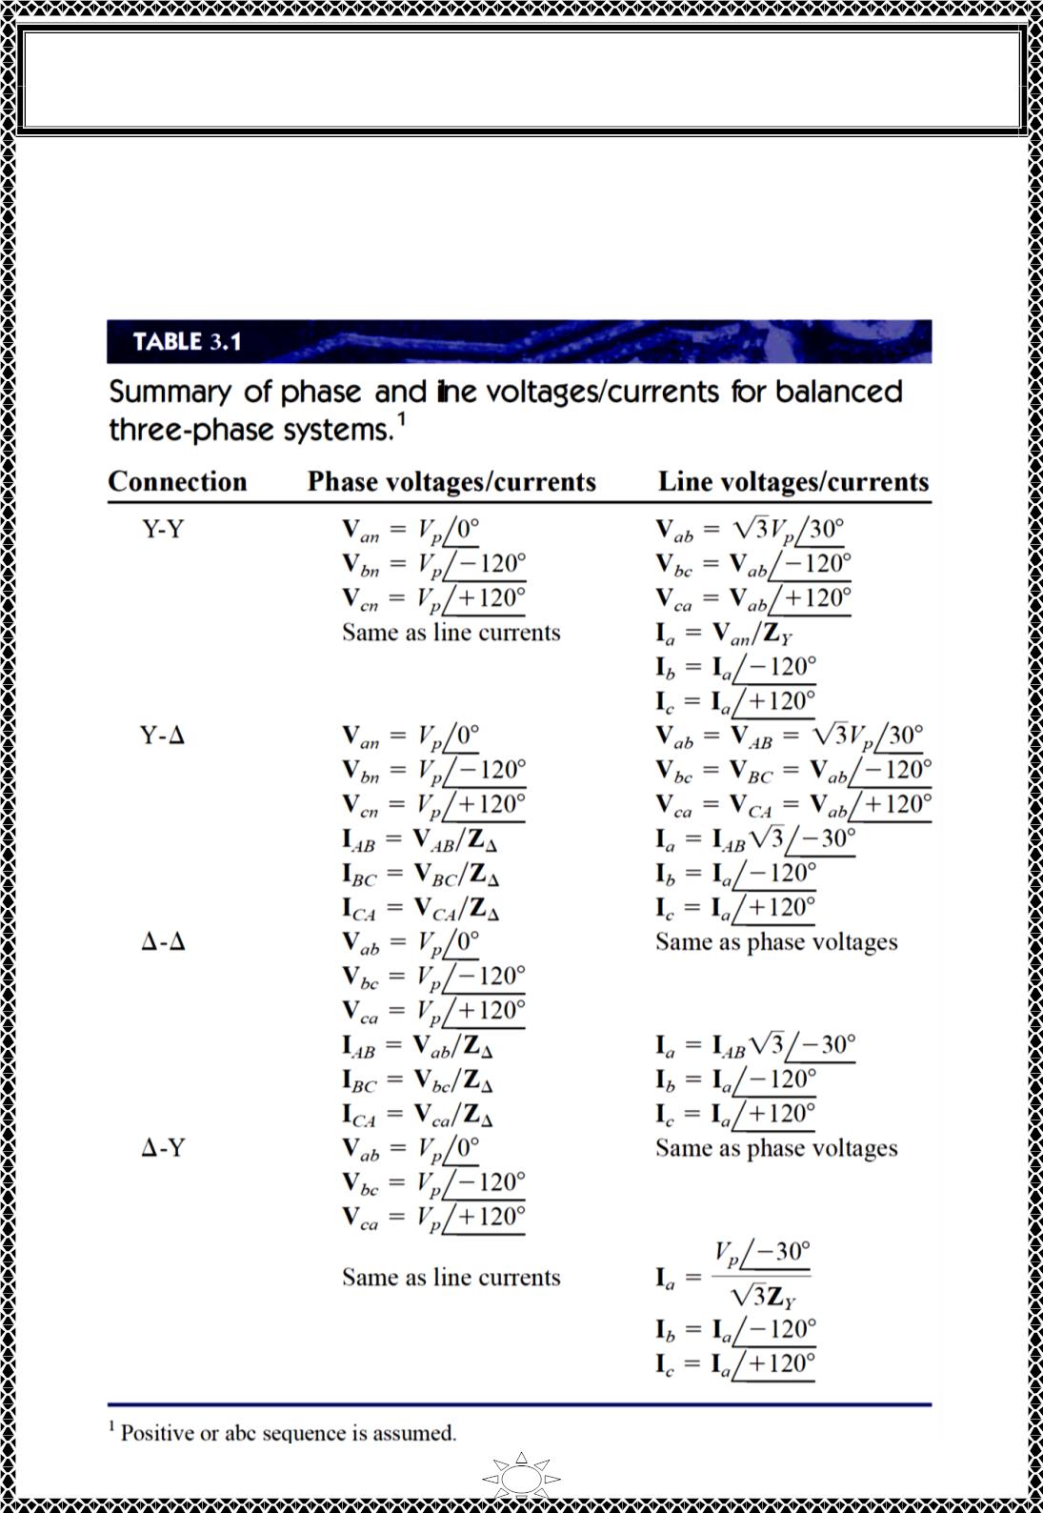
University of Diyala
Engineering College
Electronic Department
Electrical Circuits
2nd Class
Lecturer : Wisam N. AL-Obaidi
Year (2015-2016)
source is hardly used in practice, because any slight imbalance in the phase voltages will
result in unwanted circulating currents.
Table 3.1 presents a summary of the formulas for phase currents and voltages and line
currents and voltages for the four connections. Students are advised not to memorize the
formulas but to understand how they are derived. The formulas can always be
Trail Version
Trail Version
Trail Version
Trail Version
Trail Version
Trail Version
Trail Version
Trail Version
Trail Version
Trail Version
Trail Version
Trail Version
Trail Version
18

Slide 9
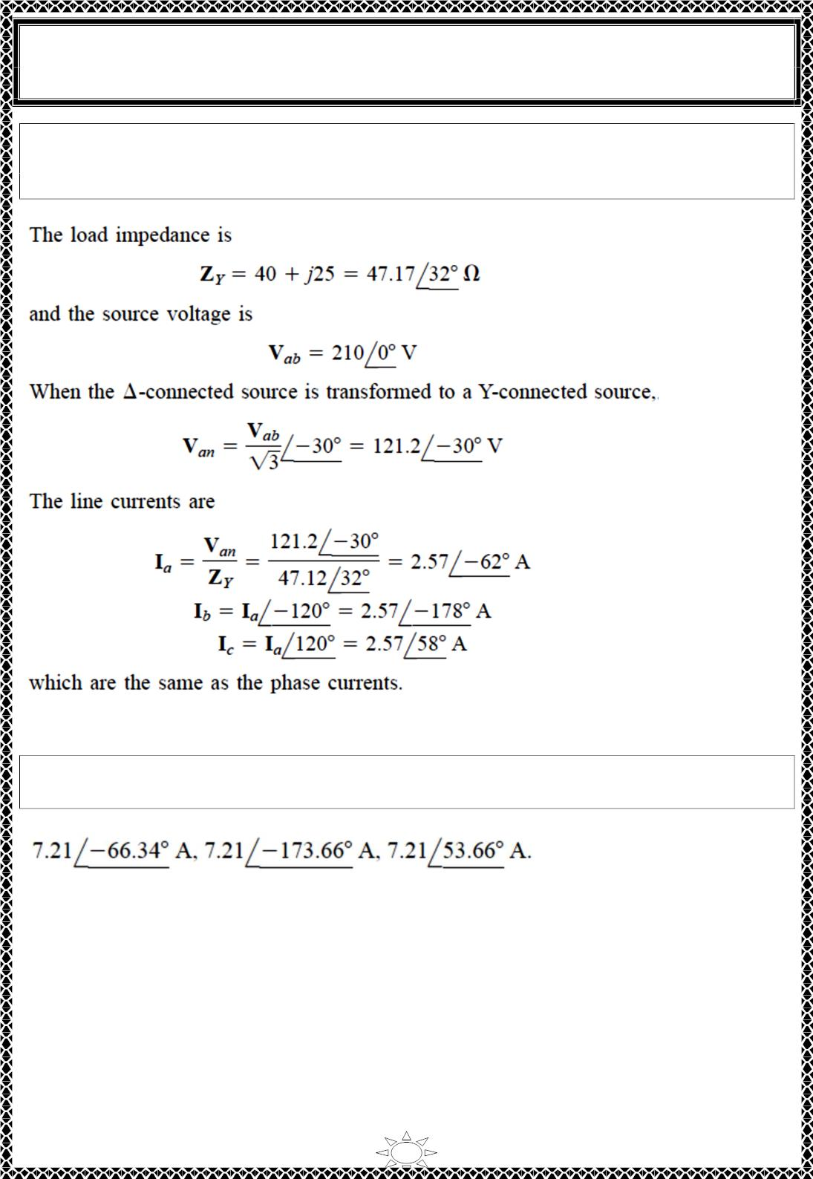
University of Diyala
Engineering College
Electronic Department
Electrical Circuits
2nd Class
Lecturer : Wisam N. AL-Obaidi
Year (2015-2016)
Example 5: A balanced Y-connected load with a phase impedance of (40 + j25) Ω is
supplied by a balanced, positive sequence ∆-connected source with a line voltage of 210
V. Calculate the phase currents. Use Vab as reference.
Solution:
Trail Version
Trail Version
Trail Version
Trail Version
Trail Version
Trail Version
Trail Version
Trail Version
Trail Version
Trail Version
Trail Version
Trail Version
Trail Version
H.W.5: In balanced ∆-Y circuit, 푽_{풂풃} = ퟐퟒퟎ∠ퟏퟓ^{ퟎ 푉} and ZY = (12 + j15) Ω. Calculate
the line currents.
Answer:
19

Slide 10
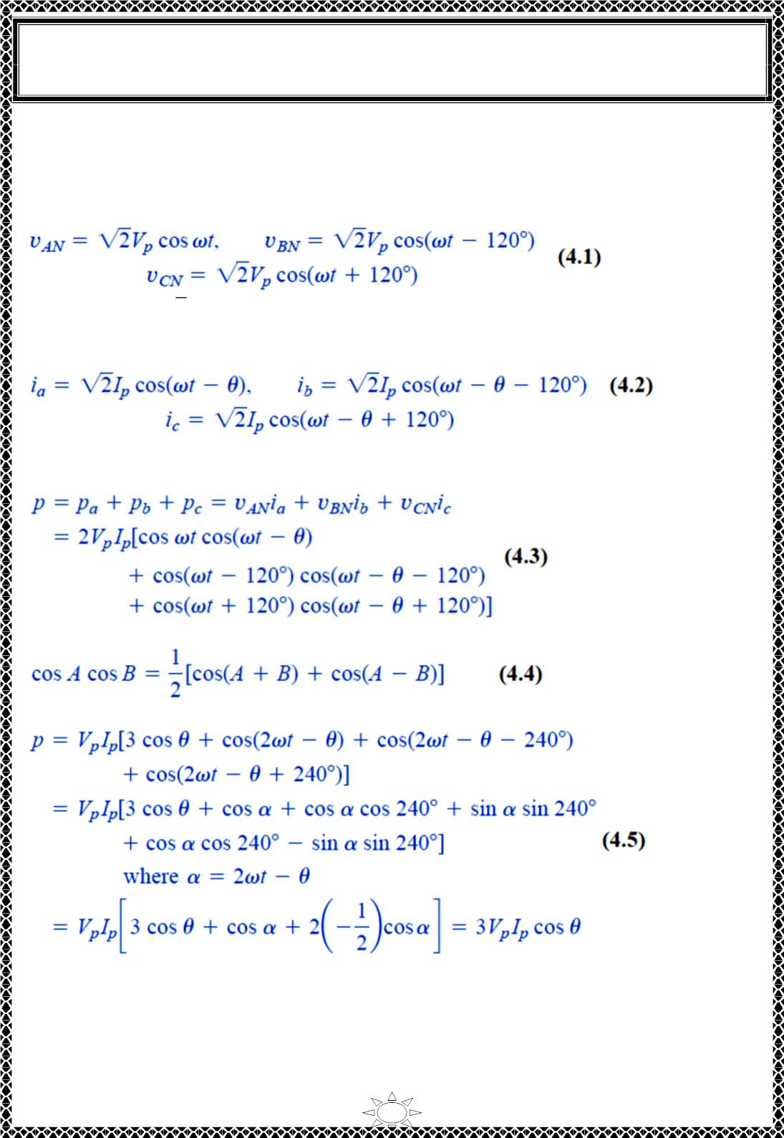
University of Diyala
Engineering College
Electronic Department
Electrical Circuits
2nd Class
Lecturer : Wisam N. AL-Obaidi
Year (2015-2016)
4) Power in a Balanced System
Let us now consider the power in a balanced three-phase system. We begin by examining
the instantaneous power absorbed by the load. This requires that the analysis be done in
the time domain. For a Y-connected load, the phase voltages are
where the factor √2 is necessary because Vp has been defined as the rms value of the phase
voltage. If 푍 = 푍∠휃 ,the phase currents lag behind their corresponding phase voltages by
휃. Thus,
푌
where Ip is the rms value of the phase current. The total instantaneous power in the load is
the sum of the instantaneous powers in the three phases; that is,
Trail Version
Trail Version
Trail Version
Trail Version
Trail Version
Trail Version
Trail Version
Trail Version
Trail Version
Trail Version
Trail Version
Trail Version
Trail Version
Applying the trigonometric identity
gives
Thus the total instantaneous power in a balanced three-phase system is constant—it does
not change with time as the instantaneous power of each phase does. This result is true
whether the load is Y- or ∆-connected.
This is one important reason for using a three-phase system to generate and distribute
power. We will look into another reason a little later. Since the total instantaneous power
20

